Slide 1
Sets and Logic
Chapter 1
Section 1
Presentation 03
03 Sets and Logic

Slide 2
Venn Diagrams
Venn Diagrams provide a pictorial views of sets.
In a Venn Diagram, a rectangle represents a universal set.
Subsets are drawn as circles.
The inside of the circle represent the members of the set.
U
A
B
03 Sets and Logic

Slide 3
Venn Diagrams
Region 1 represents (A ∪ B)^{c}.
Region 2 represents A - B.
Region 3 represents A ∩ B.
Region 4 represents B - A.
Region 2, 3 and 4 represents A ∪ B.
U
A
B
2
3
4
1
03 Sets and Logic

Slide 4
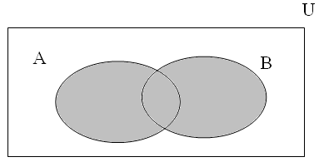
Venn Diagrams
Particular regions may be depicted by shading.
For example A ∪ B is shade below
03 Sets and Logic

Slide 5
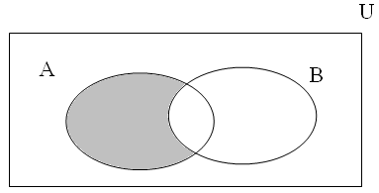
Venn Diagrams
Particular regions may be depicted by shading.
For example A - B is shade below
03 Sets and Logic

Slide 6
Venn Diagrams
A Venn Diagram with three sets
FOP, NJROTC and Honors Bio
The numbers show how many students belong to particular region depicted
FOP
NJROTC
87
8
117
8
9
17
67
Honors Bio
03 Sets and Logic

Slide 7
Venn Diagrams
For example
87 students are in FOP and not in NJROTC and not in Honors Bio
117 students are in NJROTC and not in FOP and not in Honors Bio
17 students are in NJROTC and Honors Bio and not in FOP
FOP
NJROTC
87
9
117
5
9
17
67
Honors Bio
03 Sets and Logic

Slide 8
Venn Diagrams
How many students are in FOP and Honors Bio and not in NJROTC?
How many students are in FOP, NJROTC and Honors Bio?
How many students are in FOP?
FOP
NJROTC
87
9
117
5
9
17
67
Honors Bio
03 Sets and Logic

Slide 9
Set Properties
Let U be a universal set and let A, B and C be subsets of U. The following properties hold.
  Associative laws
  (A ∪ B) ∪ C = A ∪ (B ∪ C)
  (A ∩ B) ∩ C = A ∩ (B ∩ C)
  Commutative laws
  A ∪ B = B ∪ A
  A ∩ B = B ∩ A
03 Sets and Logic

Slide 10
Set Properties
  Distributive laws
  A ∩ (B ∪ C) = (A ∩ B) ∪ (A ∩ C)
  A ∪ (B ∩ C) = (A ∪ B) ∩ (A ∪ C)
  Identity laws
  A ∪ ∅ = A
  A ∩ U= A
  Complement laws
  A ∪ A^{c} = U
  A ∩ A^{c} = ∅
03 Sets and Logic

Slide 11
Set Properties
  Idempotent laws
  A ∪ A = A
  A ∩ A = A
  Bound laws
  A ∪ U = U
  A ∩ ∅ = ∅
  Absorption laws
  A ∪ (A ∩ B) = A
  A ∩ (A ∪ B) = A
03 Sets and Logic

Slide 12
Set Properties
  Involution laws
  (A^{c})^{c} = A
  0/1 laws
  U^{c} = ∅
  ∅^{c} = U
  DeMorgan’s law for Sets
  (A ∪ B) ^{c} = A^{c} ∩ B^{c}
  (A ∩ B) ^{c} = A^{c} ∪ B^{c}
03 Sets and Logic

Slide 13
Homework
YES, YOU MUST WRITE OUT THE PROBLEM
Section Review Exercise
  Due tomorrow
    Page 11: # 26- 38 ALL
Exercises
  Due by end of class tomorrow
    Page 12: # 41-55 ALL
    yes, you may use a calculator on #55
Quizzes are now fair game
03 Sets and Logic

